Slide 1
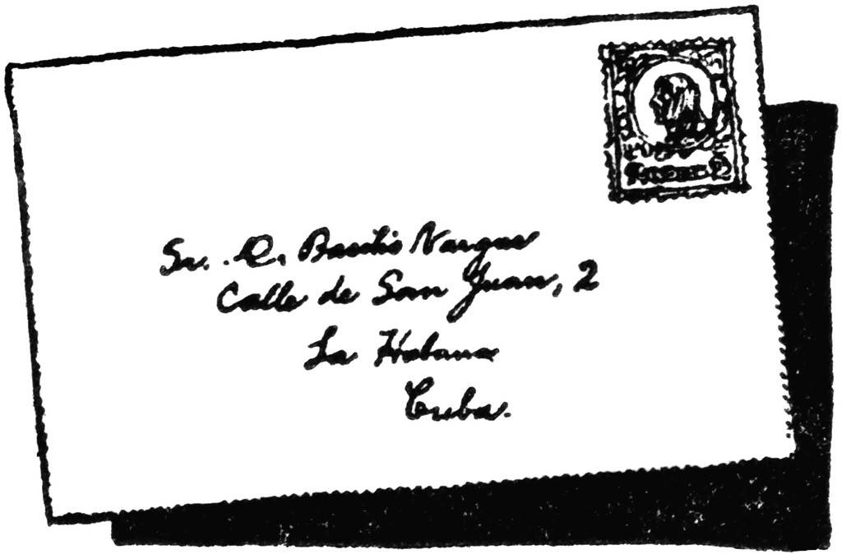
Mrs. Benton
B-7
2021-2022 School Year
No. X
Math for College Readiness
COURSE:
This is a fourth course for students who have completed Algebra !, Geometry, and Algebra II, but are still struggling with high school mathematics standards. This course serves as a bridge for high school students who will enroll in non-STEM post-secondary study and will serve to meet the high school fourth course graduation requirement.
UNITS:
Algebraic Expressions
Algebraic Equations
Measurement and Proportional Reasoning
Linear Functions
Linear Systems of Equations
Quadratic Functions
Exponential Functions
Summarizing and Interpreting Statistical Data
Complete standards are found at the following website.
https://www.georgiastandards.org/Georgia-Standards/Pages/Math-9-12.aspx
M
aterials:
Pencils
Paper
3-ring Binder
Chromebook
20%
Daily
25%
Quiz
35%
Test
20%
BMK
COURSE & UNITS
WHAT WILL
BE GRADED?
communication
I will communicate with students and parents through Remind. To subscribe, text the message @bbentonmcr to the number 81010. I also use Google Classroom as a way to contact students about assignments they need to complete. If I need to talk with a parent about a specific case, I will email or call them individually.
EMAIL:
bbenton@tcjackets.net

Slide 2
Mrs. Benton
B-7
2021-2022 School Year
No. X
The expectation is that you submit all assignments on time. I accept late assignments but there will be 10 points taken off for up to 3 days. It will be a zero after 3 days.
If you are absent, it is your responsibility to look on Google Classroom to know what you missed.
Technological issues do not excuse you from completing your work.
TECHNOLOGY
A Chromebook or your personal computer will be required for my class. Chromebooks can be checked out for free from the Media Center. A phone is NOT an acceptable substitute for a computer.
CELL PHONES ARE NOT ALLOWED IN MY CLASS.
There will be a few occasions where cell phones will be used for instructional purposes. If you have your phone in class, I will confiscate it and send it to the office for pick up at the end of the day.
LATE/MAKE-UP WORK
C
lassroom Rules:
Sit in your assigned seat.
Bring all your materials including a CHARGED Chromebook or other laptop.
Begin each day with the instructions on the SmartBoard.
You may not leave class during the first or last 10 minutes of class.
There will be no eating in class, with the exception of 5th period lunch.
The bell does not release you. Remain in your seat until I release you.
Be on time. I follow the handbook rules for tardies.
All handbook rules apply in the classroom.
If you fail to follow instructions given by the teacher, that is considered be insubordination and may result in detention or a referral.
Be respectful. Be responsible. Be successful.
This room is more than just a classroom. It’s our spot to learn, to grow, to teach, and to become productive in our scholastic efforts.. Let’s work together to build up a positive environment with lots of energy. Be respectful. Be responsible. Be successful.

